Slide 1
Keep Safe This Thanksgiving
Deep Fried Turkey
Angela Summers, PhD, PE
President
SIS-TECH Solutions
www.sis-tech.com

Slide 2
Deep frying a turkey can be quite hazardous:
Large amount of boiling oil
Propane tank
Open flame
Can be done safety without any automation
No safety alarms
No SIS

Slide 3
The Wrong Way
Turkey Deep Fat Fryer Public Service Announcment
Video Length: 1:03
Click hyperlink to play video.
When completed, navigate back to presentation.

Slide 4
The Right Way
Proper Cooking of Deep Fried Turkey
Video Length: 3:42
+ 15 sec commercial
note: product is not endorsed by SIS-TECH
nor is SIS-TECH affiliated with product manufacturer
Click hyperlink to play video.
When completed, navigate back to presentation.

Slide 5
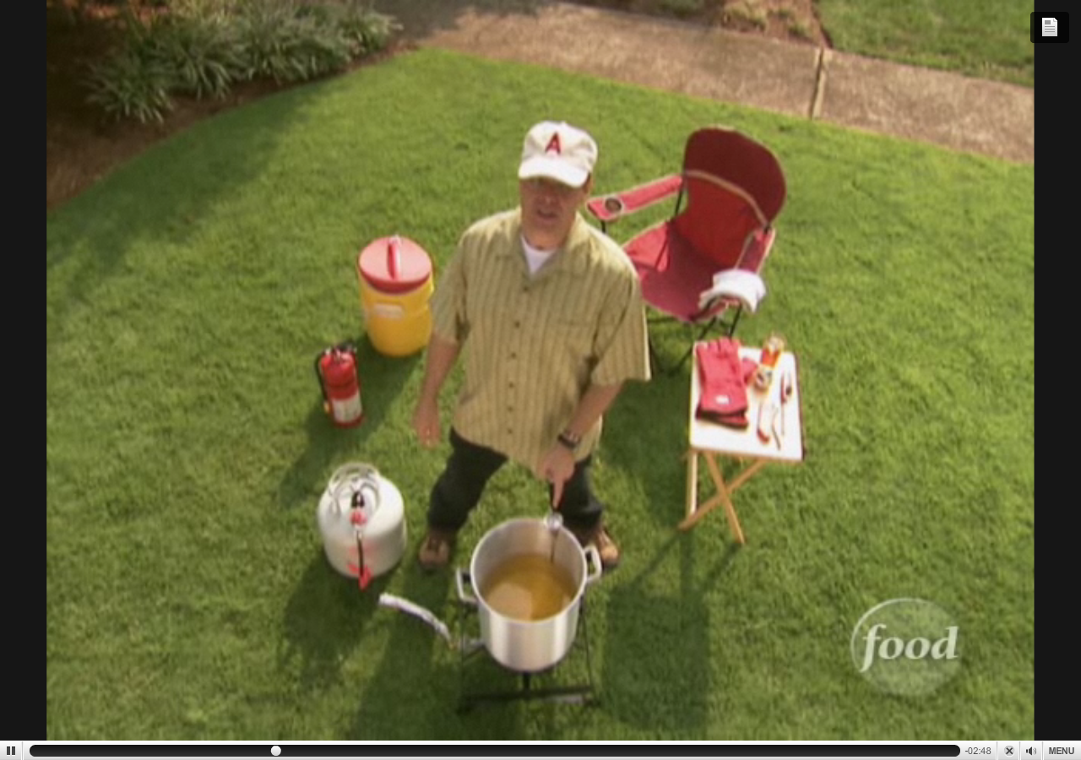
Process Supply
Turkey in cooler to maintain safe temperature to prevent spoilage

Slide 6
Process
Propane Tank
Thermometer
Fryer
Burner
Propane Hose

Slide 7
Operator Tools and Monitoring Station
Operator Station
– aka Chair
Side Towel
Competent
and
Trained Operator
Beverage
Operator to continuously monitor fryer by remaining within 10 feet of fryer while process is operational.
Heat resistant gloves
Timer
Meat Thermometer
Fire stick – aka lighter

Slide 8
Safety Measures!
Beverage
Safe Distance but close enough for monitoring purposes
Fire Extinguisher
Heat resistant gloves
Safe Distance
Foil Wrapped Propane Hose

Slide 9
Turkey Derrick
Warning Beacon
(Cooking in progress)
Rope for lowering turkey
(firming grasp using both hands
and lower slowly!)
Turkey
(Thawed completely)
Warning!
Frying a frozen turkey will cause oil to erupt from fryer!
Turkey must be completely thawed
Safe Distance
Frying oil
Start-up condition: 250F
Cooking temperature: 350F
(Oil volume determined by displacement test)

Slide 10
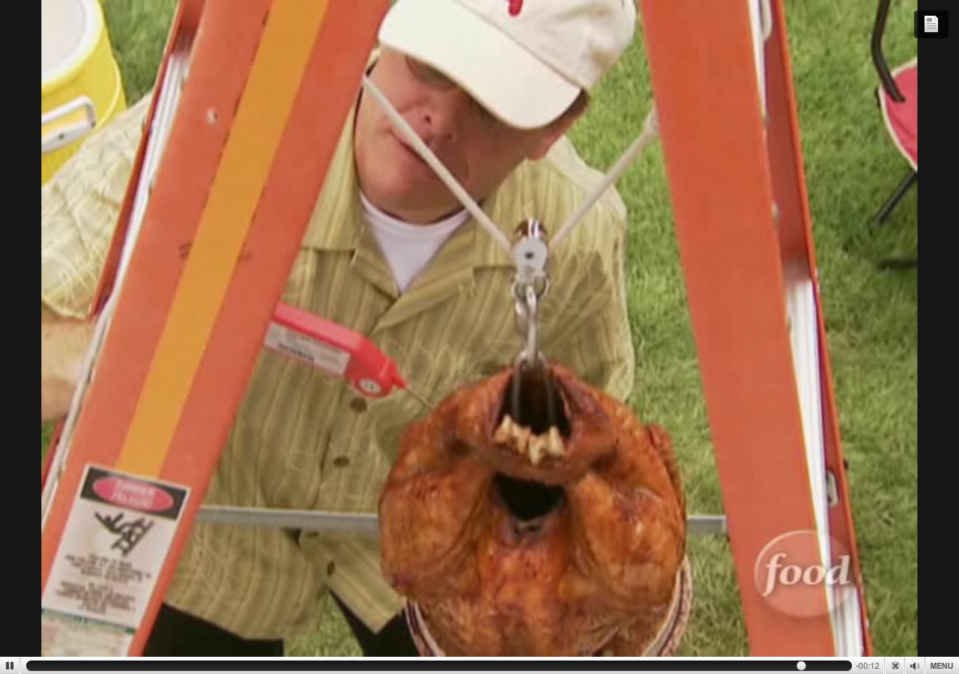
Quality Control Test:
151F after removal from oil
160F+ after resting for 15 min
Cooked Turkey
Cooking time – approximately 1 hour

Slide 11
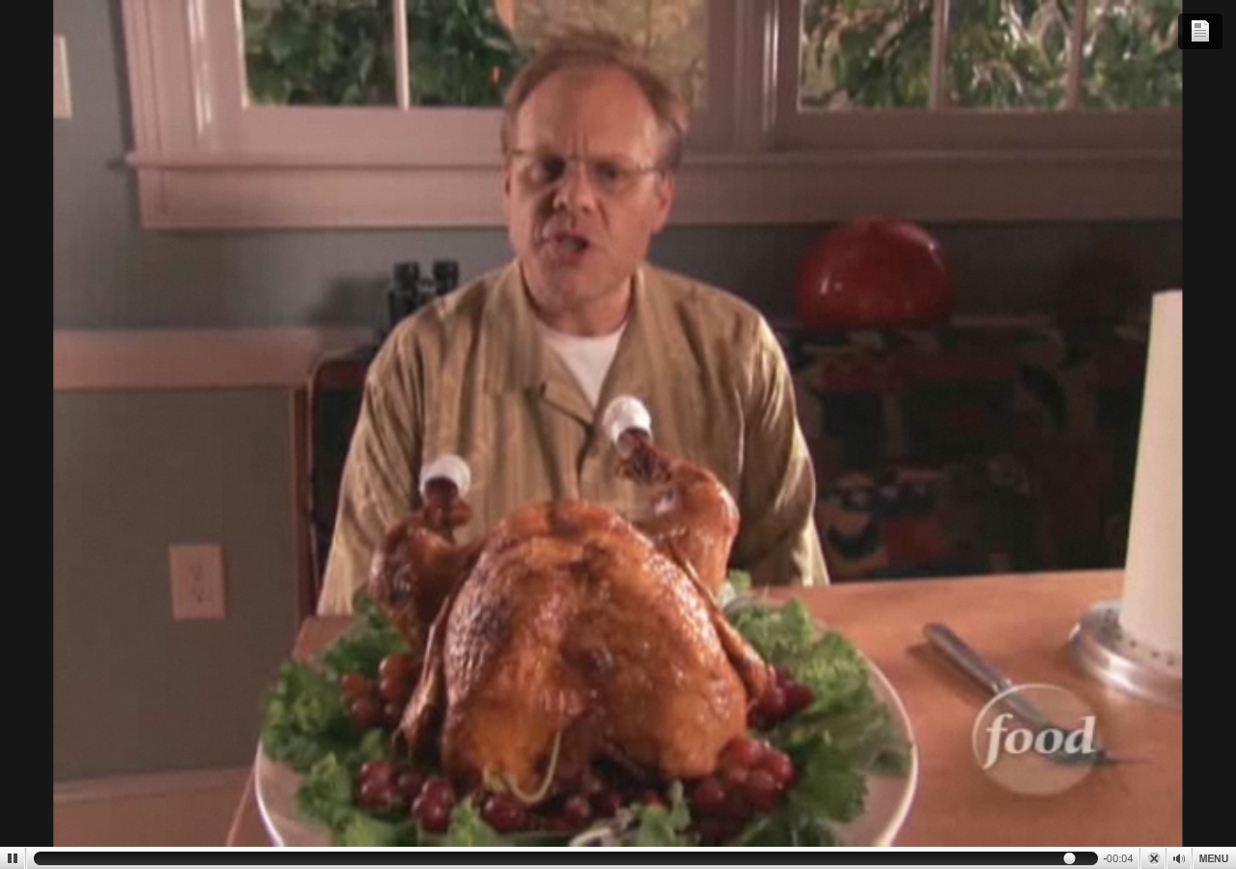
Product Delivery
Yum!

Slide 12
Recipe
http://www.foodnetwork.com/recipes/alton-brown/deep-fried-turkey-recipe/index.html
Thank you to Cobb County, Georgio, Fire Department for the public service announcement.
Thank you to Food Network and the commercial sponsor of its video.

Slide 13
API 521
5.9.1 Water into hot oil Although the entrance of water into hot oil remains a source of potential overpressure, no generally recognized method for calculating the relieving requirements is available. In a limited sense, if the quantity of water present and the heat available in the process stream are known, the size of the pressure-relief device can be calculated like that of a steam valve.. Unfortunately, the quantity of water is almost never known, even within broad limits.
Also, since the expansion in volume from liquid to vapor is so great (approximately 1:1 400 at atmospheric pressure) and the speed of vapor generation is essentially instantaneous, it is questionable whether the pressure-relief device could open fast enough to be of value. Normally, a pressure-relieving device is not provided for this contingency.

